Slide 1
CBIO204
Vaccine Research & Development Database
A normalized relational database modeling the full vaccine R&D pipeline — from candidate and antigen design through preclinical research, clinical trials, and adverse-event safety monitoring.
Name : Haneen Mohamed Fathi
ID : 221001966
Under supervision:
DR/Mohammed el sayeh
DATABASE
DBMS
SCOPE
vaccine_rnd_db
MySQL
16 relational tables

Slide 2
1 · FOUNDATION
Problem & Objective
Vaccine R&D involves multiple interconnected stages, from candidate and antigen development to manufacturing, preclinical and clinical evaluation, and participant safety monitoring. This project aims to develop a centralized relational database that integrates these stages, ensuring data consistency, traceability, and integrity while supporting key R&D processes and business rules.
Why vaccine R&D needs rigorous data design
1
Traceability
Every result links back to its candidate, batch, and trial.
What the system tracks
Vaccine candidates, antigens, and formulations
Manufacturing batches and quality status
Preclinical studies and measured results
Clinical studies, phases, and participating sites
Anonymized participant enrollment and lab results
Adverse events and vaccine safety monitoring
Integrity
2
Constraints and keys keep clinical and safety data consistent.
3
Safety
Adverse events are validated against real enrollment records.
CBIO204 · Vaccine Research & Development Database
2

Slide 3
1 · FOUNDATION
Scope & Assumptions
1
2
3
Candidate & antigen tracking
Formulation & manufacturing
Preclinical evaluation
Vaccine candidates linked to antigens with role, amount, and unit.
Antigen amounts and formulation doses must be positive when provided.
Animal-model studies and their measured results recorded per candidate.
4
5
6
Clinical development
Participant safety
Integrity by design
Study phases, multi-site studies, and site participation.
Anonymized enrollment, laboratory results, and adverse-event monitoring.
PK / FK / UNIQUE / CHECK constraints, indexes, and a live validation trigger.
CBIO204 · Vaccine Research & Development Database
3

Slide 4
1 · FOUNDATION
Major Business Rules
Enrollment completion and withdrawal dates cannot precede the enrollment date.
Every business key candidate, antigen, formulation, batch, study, site, participant, test code is unique.
Antigen amounts and formulation dose amounts must be positive when provided.
An enrollment must reference an existing clinical-study site combination.
An adverse event can only be logged for a participant already enrolled in that study, on or after enrollment enforced live by a trigger.
Preclinical and clinical study end dates cannot precede their own start dates.
CBIO204 · Vaccine Research & Development Database
3

Slide 5
2 · DATA MODEL
Main Entities — 16 Relational Tables
Candidate & Antigen
Formulation & Batch
Preclinical Research
Clinical Trials
Participants & Safety
VACCINE_CANDIDATE
FORMULATION
PRECLINICAL_STUDY
CLINICAL_PHASE
PARTICIPANT
ANTIGEN
BATCH
PRECLINICAL_RESULT
CLINICAL_STUDY
LABORATORY_TEST
CANDIDATE_ANTIGEN
STUDY_SITE
PARTICIPANT_LAB_RESULT
CLINICAL_STUDY_SITE
ADVERSE_EVENT
CLINICAL_ENROLLMENT
CBIO204 · Vaccine Research & Development Database
4

Slide 6
2 · DATA MODEL
ER Design & Cardinality
VACCINE_CANDIDATE
1:N
FORMULATION
FORMULATION
1:N
BATCH
VACCINE_CANDIDATE
M:N
ANTIGEN
resolved by associative table
VACCINE_CANDIDATE
1:N
PRECLINICAL_STUDY
PRECLINICAL_STUDY
1:N
PRECLINICAL_RESULT
VACCINE_CANDIDATE
1:N
CLINICAL_STUDY
CLINICAL_STUDY
M:N
STUDY_SITE
resolved by associative table
PARTICIPANT
M:N
CLINICAL_STUDY
resolved by associative table
PARTICIPANT
1:N
PARTICIPANT_LAB_RESULT
PARTICIPANT
1:N
ADVERSE_EVENT
CBIO204 · Vaccine Research & Development Database
5

Slide 7
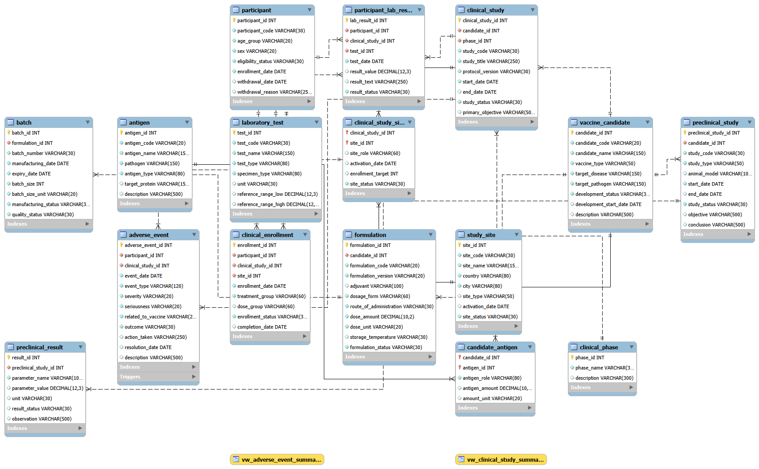
2 · DATA MODEL
ER Design & Cardinality
1:N
1:N
1:N
M:N
CBIO204 · Vaccine Research & Development Database
5

Slide 8
2 · DATA MODEL
Relational Schema & 3NF
1NF
2NF
3NF
All attributes are atomic. Antigens, batches, results, and events are stored as separate rows, not repeating groups.
Non-key attributes depend on the full primary key. Relationship-specific data (e.g. antigen_role) lives in its associative table.
Transitive dependencies are removed by separating clinical phases, formulations, test definitions, and study sites.
i
Resolving the many-to-many relationships
CANDIDATE_ANTIGEN, CLINICAL_STUDY_SITE, and CLINICAL_ENROLLMENT are associative tables that resolve every M:N relationship in the schema. CLINICAL_ENROLLMENT carries a composite foreign key back to CLINICAL_STUDY_SITE, guaranteeing that a participant can only enroll through a study–site combination that actually exists.
CBIO204 · Vaccine Research & Development Database
6

Slide 9
3 · IMPLEMENTATION
Implementation & Tech Stack
16
5
2
1
Core tables
SQL scripts
Analytical views
Validation trigger
Database layer · MySQL
create_tables.sql Creates vaccine_rnd_db, all 16 tables, PK/FK, CHECK and UNIQUE constraints, and indexes.
insert_data.sql Loads synthetic demonstration data — 10 rows per core entity.
views.sql Creates vw_clinical_study_summary and vw_adverse_event_summary.
trigger.sql Creates trg_validate_adverse_event_date.
queries.sql Demonstrates SELECT, JOIN, aggregation, subqueries, and DML operations.
CBIO204 · Vaccine Research & Development Database
7

Slide 10
3 · IMPLEMENTATION
SQL Operations Demonstrated
01
02
03
Filtering & Retrieval
Joins
Multi-table Joins
WHERE development_status IN (...) on vaccine_candidate
JOIN vaccine_candidate to formulation on candidate_id
JOIN clinical_study, vaccine_candidate, clinical_phase
04
05
06
Aggregation
HAVING & Subqueries
DML
COUNT(formulation_id) GROUP BY candidate
Enrollment counts above average formulation count
INSERT, UPDATE, and DELETE on antigen
CBIO204 · Vaccine Research & Development Database
8

Slide 11
3 · IMPLEMENTATION
Views & Advanced Database Object
VIEW
VIEW
vw_clinical_study_summary
vw_adverse_event_summary
Study code, candidate name, phase, status, distinct enrolled participants, and participating sites.
Adverse events grouped by candidate, study, severity, seriousness, vaccine relationship, and count.
TRIGGER
trg_validate_adverse_event_date
A BEFORE INSERT trigger on ADVERSE_EVENT checks that the participant is enrolled in the same clinical study, and blocks any event dated earlier than their enrollment — raising a SQLSTATE 45000 error on violation.
CBIO204 · Vaccine Research & Development Database
9

Slide 12
4 · VERIFICATION
Testing & Integrity
Valid inserts
Duplicate codes
Invalid status / dates
Invalid foreign key
Accepted
Rejected — UNIQUE
Rejected — CHECK
Rejected — FK
Non-enrolled adverse event
Event before enrollment
Valid enrollment
View execution
Blocked by trigger
Blocked by trigger
Accepted
Verified — both views return data
CBIO204 · Vaccine Research & Development Database
10

Slide 13
5 · WRAP-UP
Limitations & Future Work
Current limitations
Future improvements
Dataset is fictional, built for academic demonstration.
No authentication, authorization, or role-based permissions yet.
Anonymized participants would need stronger privacy and audit controls in production.
No automated inventory forecasting or manufacturing equipment integration.
Web or mobile interface for research teams
Role-based access control and audit history
Automated dashboards for trial progress
Laboratory-system integration
Batch release workflows
Real-time clinical safety reporting
CBIO204 · Vaccine Research & Development Database
11

Slide 14
CONCLUSION
A database that follows the vaccine, from lab bench to patient safety.
✓
Models candidate, antigen, formulation, and batch relationships end to end
✓
Connects preclinical research through multi-site clinical trials
✓
Enforces integrity with PK/FK, UNIQUE and CHECK constraints, and indexes
✓
Normalized to 3NF, with two analytical views and a safety-validation trigger

